Slide 1

Lecture 2: Build your working environment Part II
COSC 426 / 526: Introduction to Data Mining

Slide 2

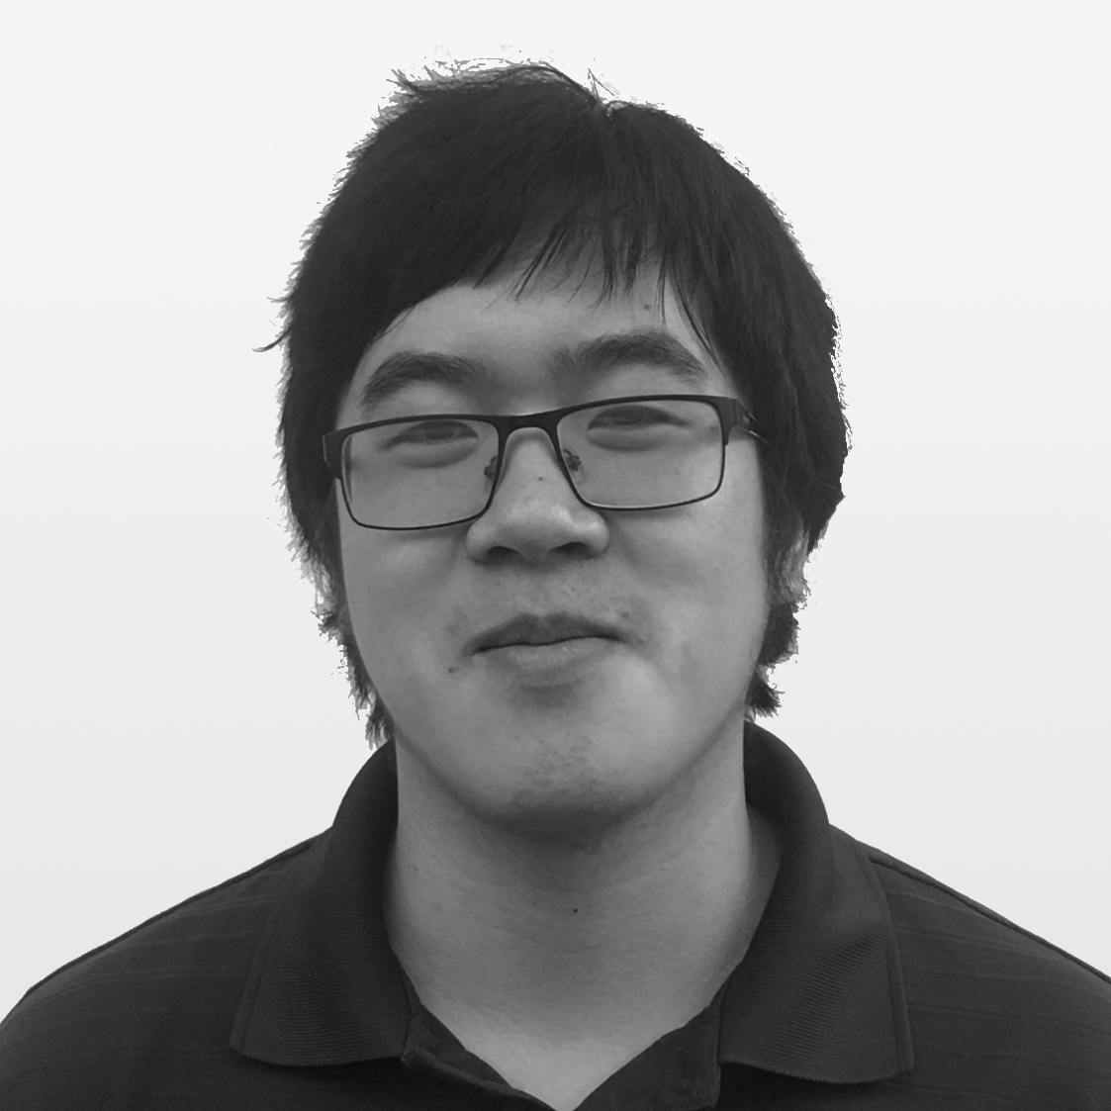


Instructor:
Assistants to the Instructor:
GTA
Ian Lumsden
Nigel Tan
Brandan Roachell
Michela Taufer
Paula Olaya

Slide 3
Assignments: Rules (I)
Assignments are due at 8 am ET on Friday after they are assigned
To submit, push your Jupyter Notebook containing your solutions to your submission repository
Your submission repository will have the same name as your GitHub username
Please make all data and additional files that are distributed with the assignment. This is not required, but it helps the TAs in grading.
You must push at least a partial submission by the due date
If you do not make a partial submission, you fail the course
3

Slide 4
Assignments: Rules (II)
If you make a partial submission, you will receive a temporary grade of “incomplete.” You will then get one additional week to complete the assignment thoroughly.
If your submission is incomplete or incorrect after the extra week, you will not automatically fail the course. However, it will negatively impact your final grade.
It would be best if you pushed your solutions to your submission repository after completing each problem. This guarantees that you will get the extra week (unless you don’t do the assignment at all)
If you have extenuating circumstances (e.g., illness), go through the official University channels to report it, and you will be accommodated in -- "Absence Notifications" section of Hilltopics: https://hilltopics.utk.edu/academics/
4

Slide 5
Course Repository

Slide 6
Clone our class repository
Using either the GitHub Desktop app or the git CLI, clone the class repo:
https://github.com/CISC879-BigData/UTK-COSC426and526-S22

Slide 7
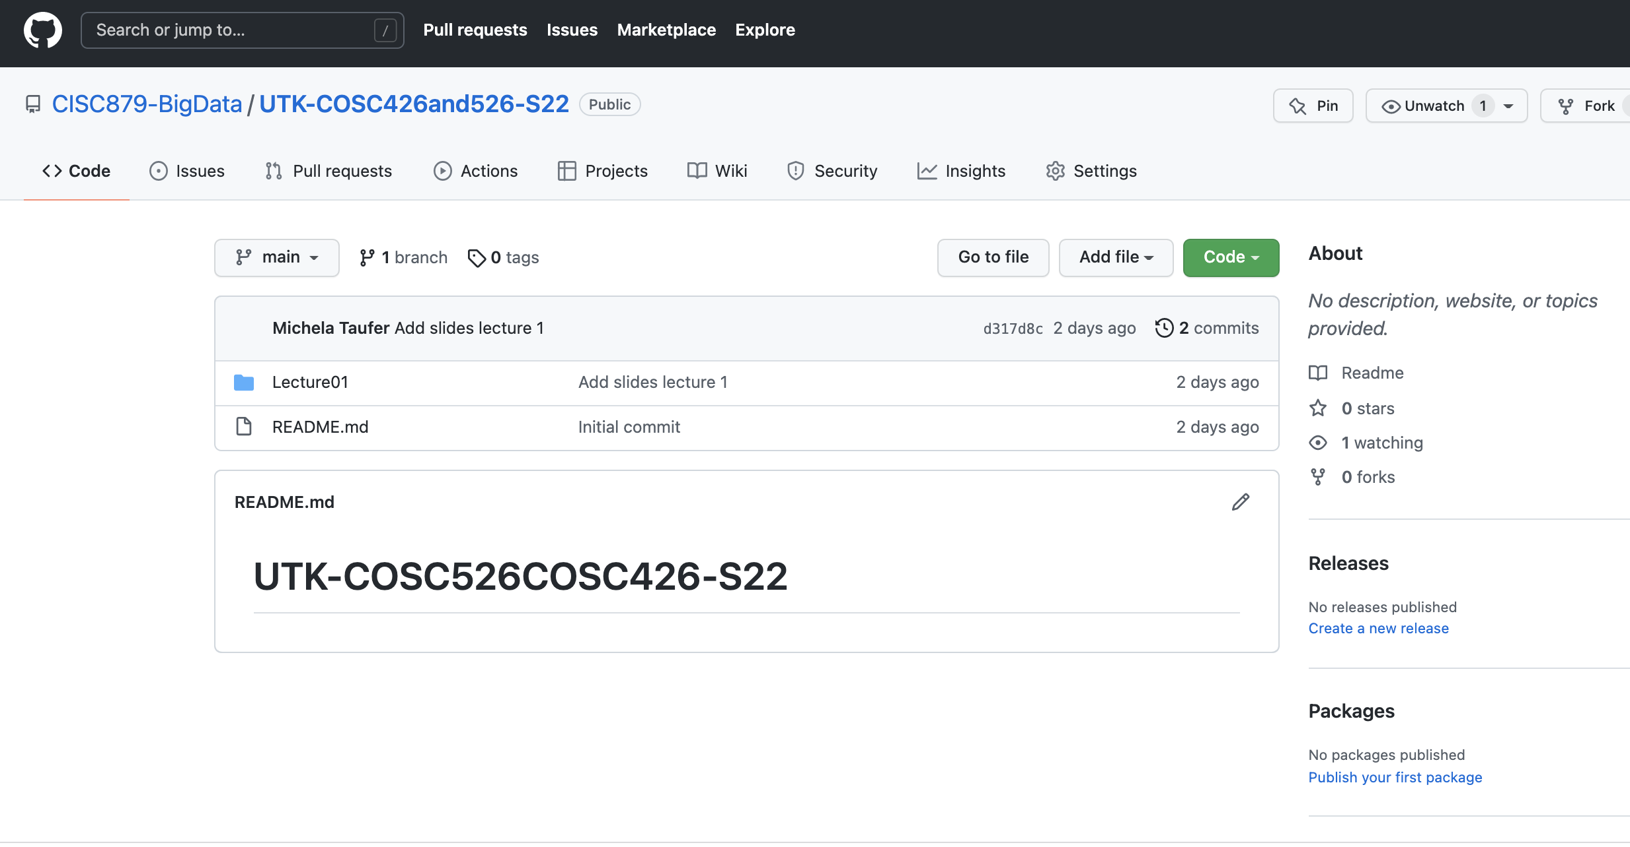
Clone the course repository
https://github.com/CISC879-BigData/UTK-COSC426and526-S23

Slide 8
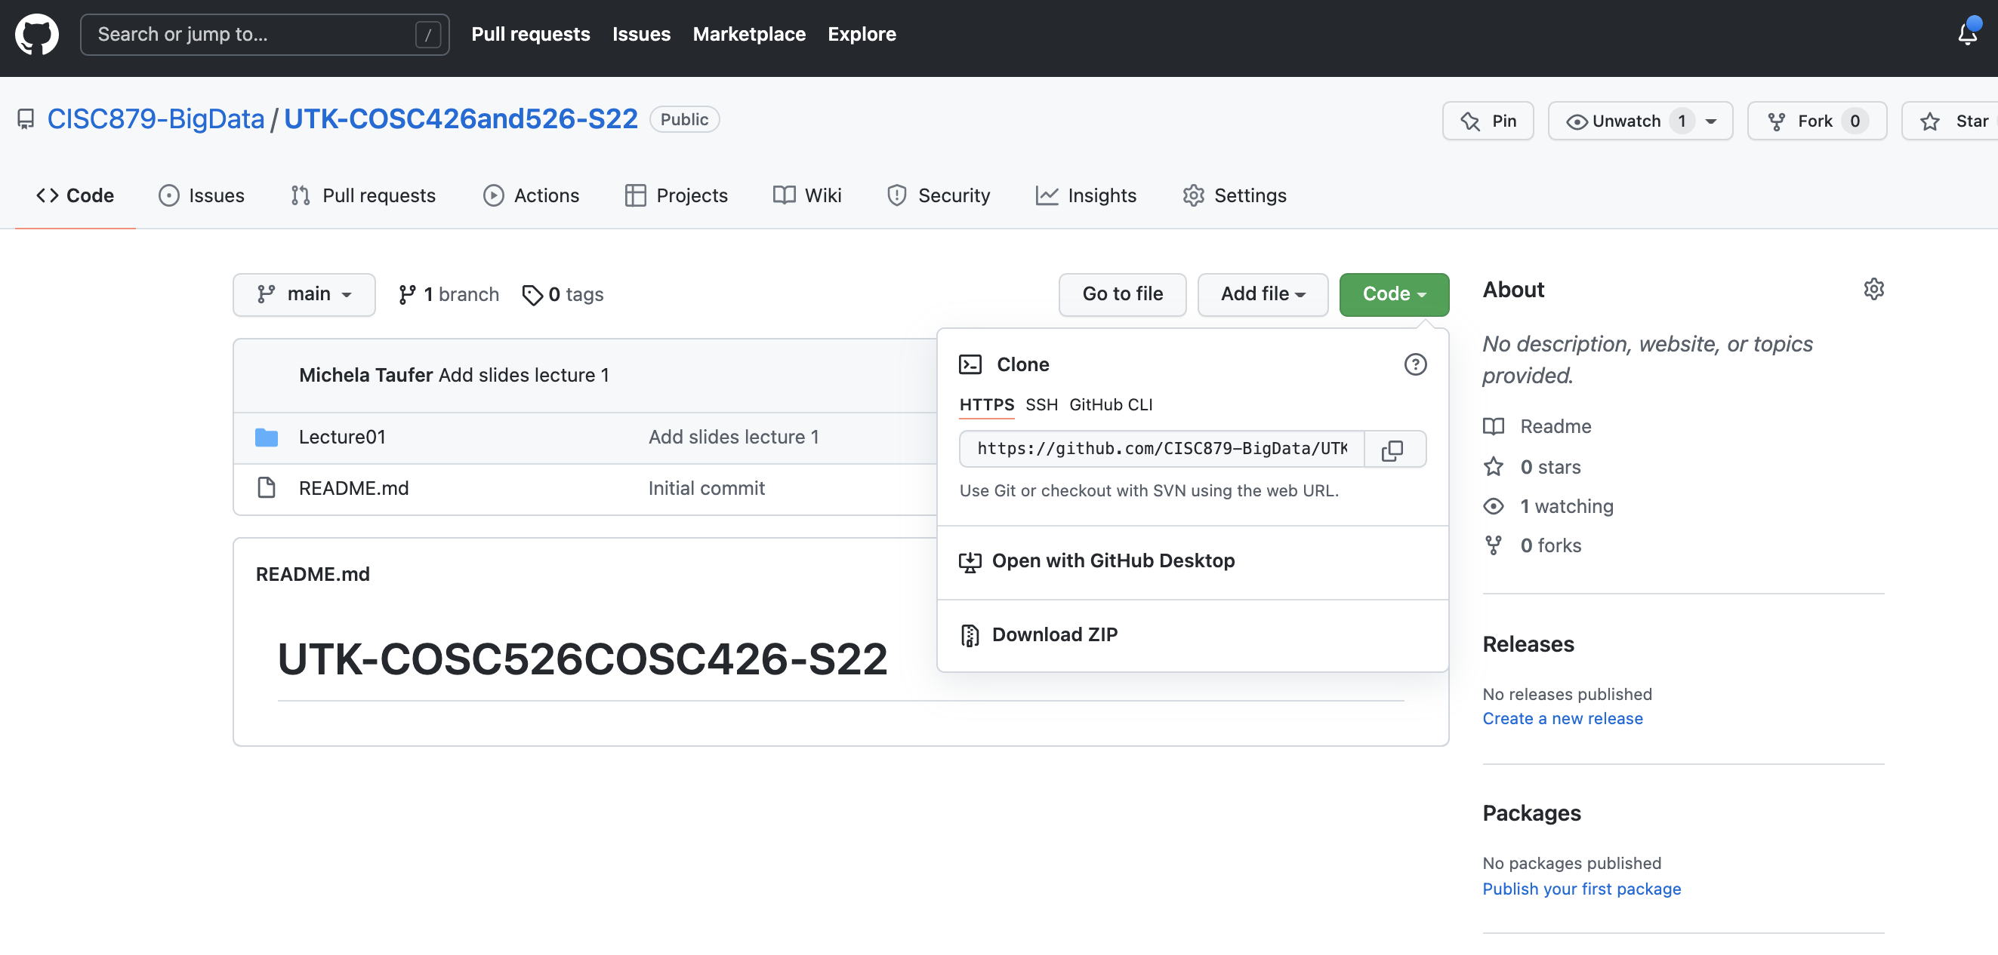
Clone the course repository

Slide 9
Open from CLI
$ git clone https://github.com/CISC879-BigData/UTK-COSC426and526-S23.git

Slide 10
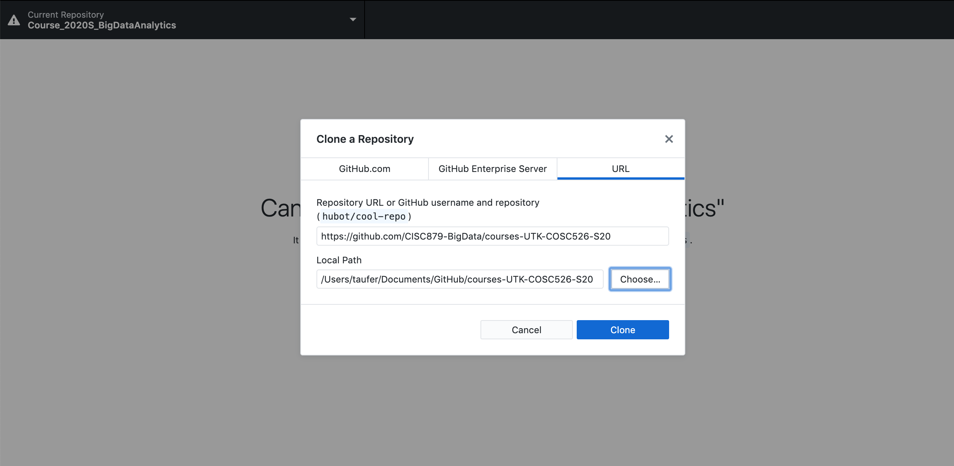
Open from GitHub Desktop

Slide 11
Get ready for Lecture 2
Get your GitHub repository ready for Lecture 2 and Assignment 2

Slide 12
We are ready to start ….

